Slide 1
UNIT-3
Greedy Method

Slide 2
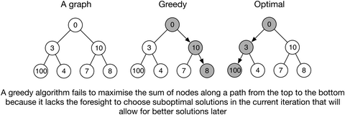
Greedy Algorithms
Greedy algorithms solves optimization problems by making the choices that seems best at the particular moment.
Optimal solution is not guaranteed but close to optimal.
It works for cases where minimization or maximization leads to the required solution.
The algorithm never reverses the earlier decision even if the choice is wrong. It works in a top-down approach.

Slide 3
Greedy Algorithm Requirements
Greedy algorithm can be used with any problem if the problem has the following properties:
Greedy Choice Property - If an optimal solution to the problem can be found by choosing the best choice at each step without reconsidering the previous steps once chosen, the problem can be solved using a greedy approach. This property is called greedy choice property.
Optimal Substructure - If the optimal overall solution to the problem corresponds to the optimal solution to its subproblems, then the problem can be solved using a greedy approach. This property is called optimal substructure.

Slide 4
Advantages of Greedy Approach
The algorithm is easier to describe.
This algorithm can perform better than other algorithms (but, not in all cases).
Drawback of Greedy Approach
As mentioned earlier, the greedy algorithm doesn't always produce the optimal solution. This is the major disadvantage of the algorithm

Slide 5
General Algorithm
To begin with, the solution set (containing answers) is empty.
At each step, an item is added to the solution set until a solution is reached.
If the solution set is feasible, the current item is kept.
Else, the item is rejected and never considered again.

Slide 6
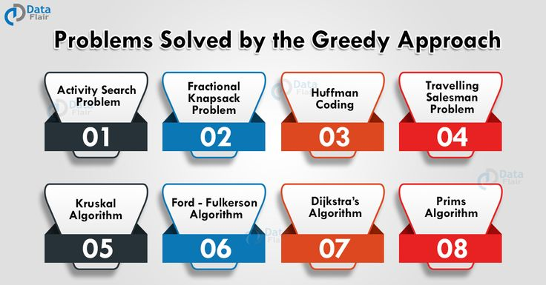
Applications

Slide 7
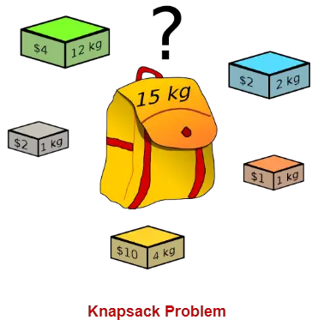
Knapsack Problem
Given-
A knapsack (kind of shoulder bag) with limited weight capacity.
Few items each having some weight and value.
The problem states which items should be placed into the knapsack such that-
The value or profit obtained by putting the items into the knapsack is maximum.
And the weight limit of the knapsack does not exceed.

Slide 8
Knapsack Problem Variants
0/1 Knapsack Problem -we can either put an item completely into the bag or cannot put it at all.
Fractional Knapsack Problem - we can break items for maximizing the total value of the knapsack.
Bounded Knapsack – we need to maximize the value by selecting a maximum of K items.
Unbounded Knapsack – we are allowed to use an unlimited number of instances of an item.

Slide 9
Fractional Knapsack Problem
Given the weights and profits of N items, in the form of {profit, weight} put these items in a knapsack of capacity W to get the maximum total profit in the knapsack.
In Fractional Knapsack, we can break items for maximizing the total value of the knapsack.
It is solved using Greedy Method.

Slide 10
Approach for Solution
Input: arr[] = {{80, 10}, {60, 20}, {120, 30}}, W = 50 // {value, weight}
CASE 1: Choose more weight first.
Solution: Item 3, Item 2 are selected. Value: 120+60 =180.
CASE 2: Choose more profit first.
Solution: Item 3 and 1 are selected. Value: 120+80=200

Slide 11
Greedy based apparoach
The basic idea of the greedy approach is to calculate the ratio profit/weight for each item and sort the item on the basis of this ratio. Then take the item with the highest ratio and add them as much as we can (can be the whole element or a fraction of it).
This will always give the maximum profit because, in each step it adds an element such that this is the maximum possible profit for that much weight.

Slide 12
Step-1: For each item, compute its value/weight ratio.
Step-2: Arrange all the items in decreasing order of their value/weight ratio.
Step-3: Start putting the items into the knapsack beginning from the item with the highest ratio.
Put as many items as you can into the knapsack.
ALGORITHM
Calculate the ratio (profit/weight) for each item.
Sort all the items in decreasing order of the ratio.
Initialize res = 0, curr_cap = given_cap.
Do the following for every item i in the sorted order:
If the weight of the current item is less than or equal to the remaining capacity then add the value of that item into the result
Else add the current item as much as we can and break out of the loop.
Return res.

Slide 13
Time Complexity
The main time taking step is the sorting of all items in decreasing order of their value / weight ratio.
If the items are already arranged in the required order, then while loop takes O(n) time.
The average time complexity of Quick Sort is O(nlogn).
Therefore, total time taken including the sort is O(nlogn).

Slide 14
Example-1
Consider the example: arr[] = {{100, 20}, {60, 10}, {120, 30}}, W = 50.
Sorting: Initially sort the array based on the profit/weight ratio. The sorted array will be {{60, 10}, {100, 20}, {120, 30}}.
Iteration:
For i = 0, weight = 10 which is less than W. So add this element in the knapsack. profit = 60 and remaining W = 50 – 10 = 40.
For i = 1, weight = 20 which is less than W. So add this element too. profit = 60 + 100 = 160 and remaining W = 40 – 20 = 20.
For i = 2, weight = 30 is greater than W. So add 20/30 fraction = 2/3 fraction of the element. Therefore profit = 2/3 * 120 + 160 = 80 + 160 = 240 and remaining W becomes 0.
So the final profit becomes 240 for W = 50.

Slide 15
Example-2
A thief enters a house for robbing it. He can carry a maximal weight of 60 kg into his bag. There are 5 items in the house with the following weights and values. What items should thief take if he can even take the fraction of any item with him?
Item | Weight | Value
1 | 5 | 30
2 | 10 | 40
3 | 15 | 45
4 | 22 | 77
5 | 25 | 90

Slide 16
Solution
Items | Weight | Value | Ratio
1 | 5 | 30 | 6
2 | 10 | 40 | 4
3 | 15 | 45 | 3
4 | 22 | 77 | 3.5
5 | 25 | 90 | 3.6
Step-1: Compute the value / weight ratio for each item.
Step-2: Sort all the items in decreasing order of their
value / weight ratio.
I1 I2 I5 I4 I3
Step-3: Start filling the knapsack by putting the items into it one by one.
Knapsack Weight | Items in Knapsack | Cost
60 | Ø | 0
55 | I1 | 30
45 | I1, I2 | 70
20 | I1, I2, I5 | 160

Slide 17
Solution(contd.)
Now,
Knapsack weight left to be filled is 20 kg but item-4 has a weight of 22 kg.
Since in fractional knapsack problem, even the fraction of any item can be taken.
So, knapsack will contain the following items-
< I1 , I2 , I5 , (20/22) I4 >
Total cost of the knapsack
= 160 + (20/27) x 77
= 160 + 70
= 230 units

Slide 18
Activity Selection Problem
Given N activities with their start time and end time. The task is to find the solution set having a maximum number of non-conflicting activities that can be executed within the given time, assuming only a single activity can be performed at a given time.
You are given n activities with their start and finish times. Select the maximum number of activities that can be performed by a single person, assuming that a person can only work on a single activity at a time.
Input: start[] = {10, 12, 20}, finish[] = {20, 25, 30}
Output: 0 2
Explanation: A person can perform at most two activities. The
maximum set of activities that can be executed
is {0, 2} [ These are indexes in start[] and finish[] ]

Slide 19
Solution Approach
It might not be possible to complete all the activities, since their timings can collapse.
Two activities, say i and j, are said to be non-conflicting if si >= fj or sj >= fi where si and sj denote the starting time of activities i and j respectively, and fi and fj refer to the finishing time of the activities i and j respectively.
Greedy approach can be used to find the solution since we want to maximize the count of activities that can be executed. This approach will greedily choose an activity with earliest finish time at every step, thus yielding an optimal solution.

Slide 20
Input Data for the Algorithm:
act[] array containing all the activities.
s[] array containing the starting time of all the activities.
f[] array containing the finishing time of all the activities.
Ouput Data from the Algorithm:
sol[] array refering to the solution set containing the maximum number of non-conflicting activities.

Slide 21
Steps for Activity Selection Problem
Step 1: Sort the given activities in ascending order according to their finishing time.
Step 2: Select the first activity from sorted array act[] and add it to sol[] array.
Step 3: Repeat steps 4 and 5 for the remaining activities in act[].
Step 4: If the start time of the currently selected activity is greater than or equal to the finish time of previously selected activity, then add it to the sol[] array.
Step 5: Select the next activity in act[] array.
Step 6: Print the sol[] array.

Slide 22
Example-1
In the table below, we have 6 activities with corresponding start and end time, the objective is to compute an execution schedule having maximum number of non-conflicting activities:
Start Time (s) | Finish Time (f) | Activity Name
5 | 9 | a1
1 | 2 | a2
3 | 4 | a3
0 | 6 | a4
5 | 7 | a5
8 | 9 | a6

Slide 23
Step 1: Sort the given activities in ascending order according to their finishing time.
Step 2: Select the first activity from sorted array act[] and add it to the sol[] array, thus sol = {a2}.
Step 3: Repeat the steps 4 and 5 for the remaining activities in act[].
Step 4: If the start time of the currently selected activity is greater than or equal to the finish time of the previously selected activity, then add it to sol[].
Start Time (s) | Finish Time (f) | Activity Name
1 | 2 | a2
3 | 4 | a3
0 | 6 | a4
5 | 7 | a5
5 | 9 | a1
8 | 9 | a6

Slide 24
Step 5: Select the next activity in act[]
For the data given in the above table,
Select activity a3. Since the start time of a3 is greater than the finish time of a2 (i.e. s(a3) > f(a2)), we add a3 to the solution set. Thus sol = {a2, a3}.
Select a4. Since s(a4) < f(a3), it is not added to the solution set.
Select a5. Since s(a5) > f(a3), a5 gets added to solution set. Thus sol = {a2, a3, a5}
Select a1. Since s(a1) < f(a5), a1 is not added to the solution set.
Select a6. a6 is added to the solution set since s(a6) > f(a5). Thus sol = {a2, a3, a5, a6}.
Step 6: At last, print the array sol[]

Slide 25
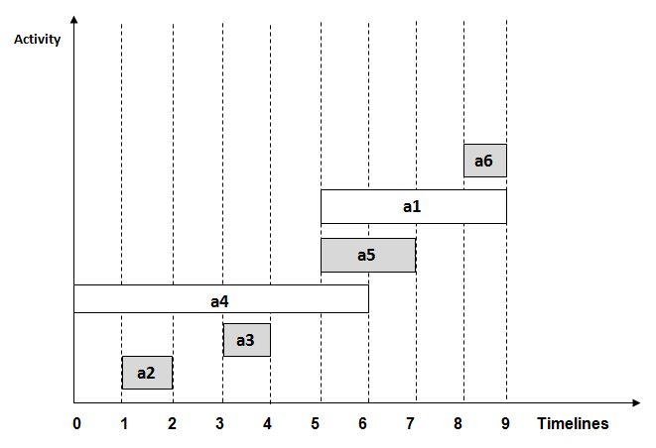

Slide 26
Time Complexity
Case 1: When a given set of activities are already sorted according to their finishing time, then there is no sorting mechanism involved, in such a case the complexity of the algorithm will be O(n)
Case 2: When a given set of activities is unsorted, then we will have to sort the activities list. The time complexity of this method will be O(nlogn), which also defines complexity of the algorithm.

Slide 27
Real-life Applications of Activity Selection Problem
Scheduling multiple competing events in a room, such that each event has its own start and end time.
Scheduling manufacturing of multiple products on the same machine, such that each product has its own production timelines.
Activity Selection is one of the most well-known generic problems used in Operations Research for dealing with real-life business problems.

Slide 28
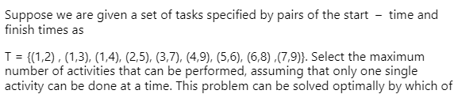
Practice Question

Slide 29
Huffman Coding

Slide 30
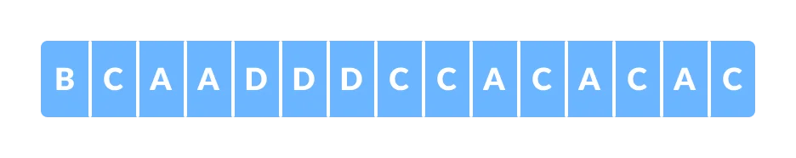
Introduction
Huffman Coding is a technique of compressing data to reduce its size without losing any of the details. It was first developed by David Huffman.
Huffman Coding is generally useful to compress the data in which there are frequently occurring characters.
Each character occupies 8 bits. There are a total of 15 characters in the above string. Thus, a total of 8 * 15 = 120 bits are required to send this string.
Using the Huffman Coding technique, we can compress the string to a smaller size.

Slide 31
Types of Encoding
Fixed-Length encoding - Every character is assigned a binary code using same number of bits. Thus, a string like “aabacdad” can require 64 bits (8 bytes) for storage or transmission, assuming that each character uses 8 bits.
Variable- Length encoding - As opposed to Fixed-length encoding, this scheme uses variable number of bits for encoding the characters depending on their frequency in the given text. Thus, for a given string like “aabacdad”, frequency of characters ‘a’, ‘b’, ‘c’ and ‘d’ is 4,1,1 and 2 respectively. Since ‘a’ occurs more frequently than ‘b’, ‘c’ and ‘d’, it uses least number of bits, followed by ‘d’, ‘b’ and ‘c’.

Slide 32
Prefix Rule
Suppose we randomly assign binary codes to each character as follows-
a 0 b 011 c 111 d 11 Thus, the string “aabacdad” gets encoded to 00011011111011 (0 | 0 | 011 | 0 | 111 | 11 | 0 | 11), using fewer number of bits compared to fixed-length encoding scheme.
But the real problem lies with the decoding phase. If we try and decode the string 00011011111011, it will be quite ambiguous since, it can be decoded to the multiple strings, few of which are-
aaadacdad (0 | 0 | 0 | 11 | 0 | 111 | 11 | 0 | 11) aaadbcad (0 | 0 | 0 | 11 | 011 | 111 | 0 | 11) aabbcb (0 | 0 | 011 | 011 | 111 | 011)… and so on
To prevent such ambiguities during decoding, the encoding phase should satisfy the “prefix rule” which states that no binary code should be a prefix of another code. This will produce uniquely decodable codes. The above codes for ‘a’, ‘b’, ‘c’ and ‘d’ do not follow prefix rule since the binary code for a, i.e. 0, is a prefix of binary code for b i.e 011, resulting in ambiguous decodable codes.

Slide 33
Lets reconsider assigning the binary codes to characters ‘a’, ‘b’, ‘c’ and ‘d’.
a 0 b 11 c 101 d 100Using the above codes, string “aabacdad” gets encoded to 001101011000100 (0 | 0 | 11 | 0 | 101 | 100 | 0 | 100). Now, we can decode it back to string “aabacdad”.

Slide 34
Steps for creating the Huffman Tree
Step 1- Create a leaf node for each character and build a min heap using all the nodes (The frequency value is used to compare two nodes in min heap)
Step 2- Repeat Steps 3 to 5 while heap has more than one node
Step 3- Extract two nodes, say x and y, with minimum frequency from the heap
Step 4- Create a new internal node z with x as its left child and y as its right child. Also frequency(z)= frequency(x)+frequency(y)
Step 5- Add z to min heap
Step 6- Last node in the heap is the root of Huffman tree

Slide 35

Example
Char | a | e | i | o | u | s | t
Frequency | 10 | 15 | 12 | 3 | 4 | 13 | 1
Step 1- Create a leaf node for each character and build a min heap using all the nodes (The frequency value is used to compare two nodes in min heap)

Slide 36
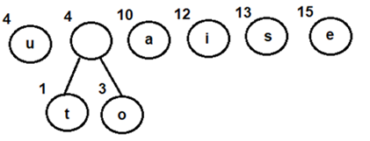
Repeat the following steps till heap has more than one nodes
Step 3- Extract two nodes, say x and y, with minimum frequency from the heap
Step 4- Create a new internal node z with x as its left child and y as its right child. Also frequency(z)= frequency(x)+frequency(y)
Step 5- Add z to min heap
Extract and Combine node u with an internal node having 4 as the frequency
Add the new internal node to priority queue-

Slide 37
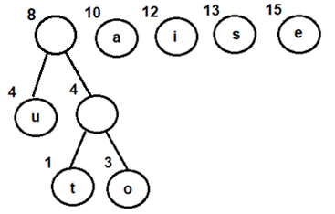
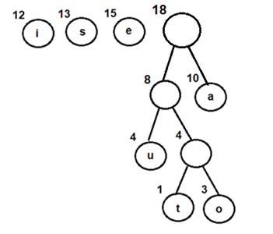
Extract and Combine node with an internal node having 8 as the frequency
Add the new internal node to priority queue-
Extract and Combine nodes i and s
Add the new internal node to priority queue-

Slide 38
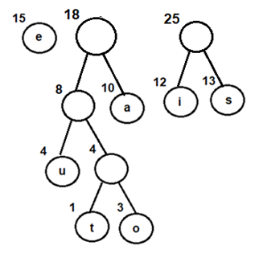
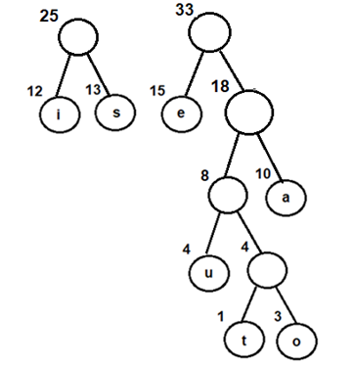
Extract and Combine nodes i and s
Add the new internal node to priority queue-
Extract and Combine node e with an internal
node having 18 as the frequency
Add the new internal node to priority queue-

Slide 39
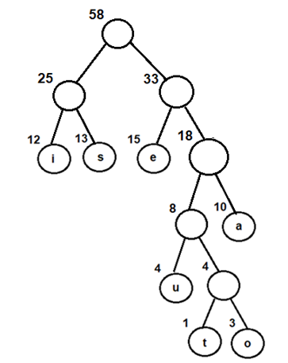
Finally, Extract and Combine internal nodes having 25 and 33 as the frequency
Add the new internal node to priority queue-
Since internal node with frequency 58 is the
only node in the queue, it becomes the root of
Huffman tree.
Step 6- Last node in the heap is the root of
Huffman tree

Slide 40
Steps for traversing the Huffman Tree
Create an auxiliary array
Traverse the tree starting from root node
Add 0 to array while traversing the left child and add 1 to array while traversing the right child
Print the array elements whenever a leaf node is found
Following the above steps for Huffman Tree generated above, we get prefix-free and variable-length binary codes with minimum expected code word length-

Slide 41
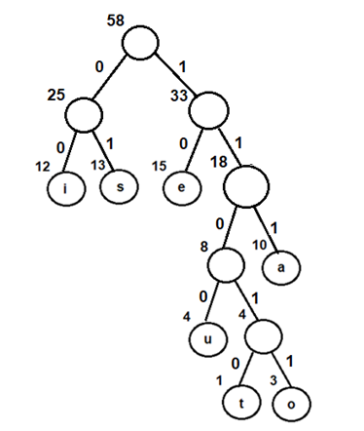
Assigning Binary Codes

Slide 42
Characters | Binary Codes
i | 00
s | 01
e | 10
u | 1100
t | 11010
o | 11011
a | 111

Slide 43
Coding and Decoding
Suppose the string “staeiout” needs to be transmitted from computer A (sender) to computer B (receiver) across a network. Using concepts of Huffman encoding, the string gets encoded to “0111010111100011011110011010” (01 | 11010 | 111 | 10 | 00 | 11011 | 1100 | 11010) at the sender side.
Once received at the receiver’s side, it will be decoded back by traversing the Huffman tree. For decoding each character, we start traversing the tree from root node. Start with the first bit in the string. A ‘1’ or ‘0’ in the bit stream will determine whether to go left or right in the tree. Print the character, if we reach a leaf node.

Slide 44
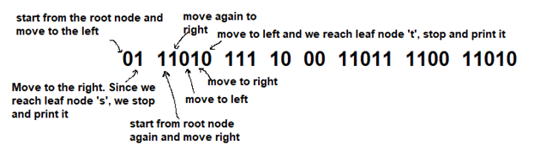

Slide 45
111 gets decoded to ‘a’
10 gets decoded to ‘e’
00 gets decoded to ‘i’
11011 gets decoded to ‘o’
1100 gets decoded to ‘u’
And finally, 11010 gets decoded to ‘t’, thus returning the string “staeiout” back

Slide 46
Advantages of Huffman Encoding
This encoding scheme results in saving lot of storage space, since the binary codes generated are variable in length
It generates shorter binary codes for encoding symbols/characters that appear more frequently in the input string
The binary codes generated are prefix-free

Slide 47
Time Complexity
O(nlogn) where n is the number of unique characters. If there are n nodes, extractMin() is called 2*(n – 1) times. extractMin() takes O(logn) time as it calls minHeapify(). So, the overall complexity is O(nlogn).

Slide 48
Disadvantages of Huffman Encoding
Lossless data encoding schemes, like Huffman encoding, achieve a lower compression ratio compared to lossy encoding techniques. Thus, lossless techniques like Huffman encoding are suitable only for encoding text and program files and are unsuitable for encoding digital images.
Huffman encoding is a relatively slower process since it uses two passes- one for building the statistical model and another for encoding. Thus, the lossless techniques that use Huffman encoding are considerably slower than others.
Since length of all the binary codes is different, it becomes difficult for the decoding software to detect whether the encoded data is corrupt. This can result in an incorrect decoding and subsequently, a wrong output.

Slide 49
Applications
Huffman encoding is widely used in compression formats like GZIP,PKZIP (winzip) and BZIP2.
Multimedia codecs like JPEG,PNG and MP3 uses Huffman encoding (to be more precised the prefix codes)
Huffman encoding still dominates the compression industry since newer arithmetic and range coding schemes are avoided due to their patent issues.

